Slide 1
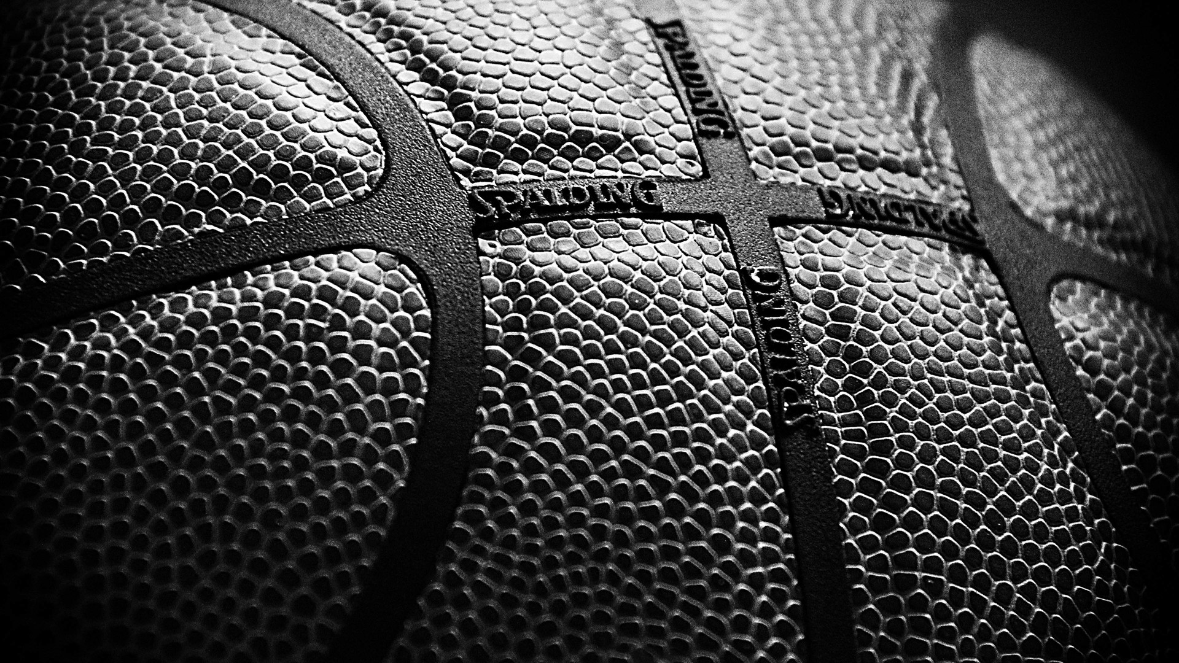
TEAM06
NBA lottery prediction

Slide 2

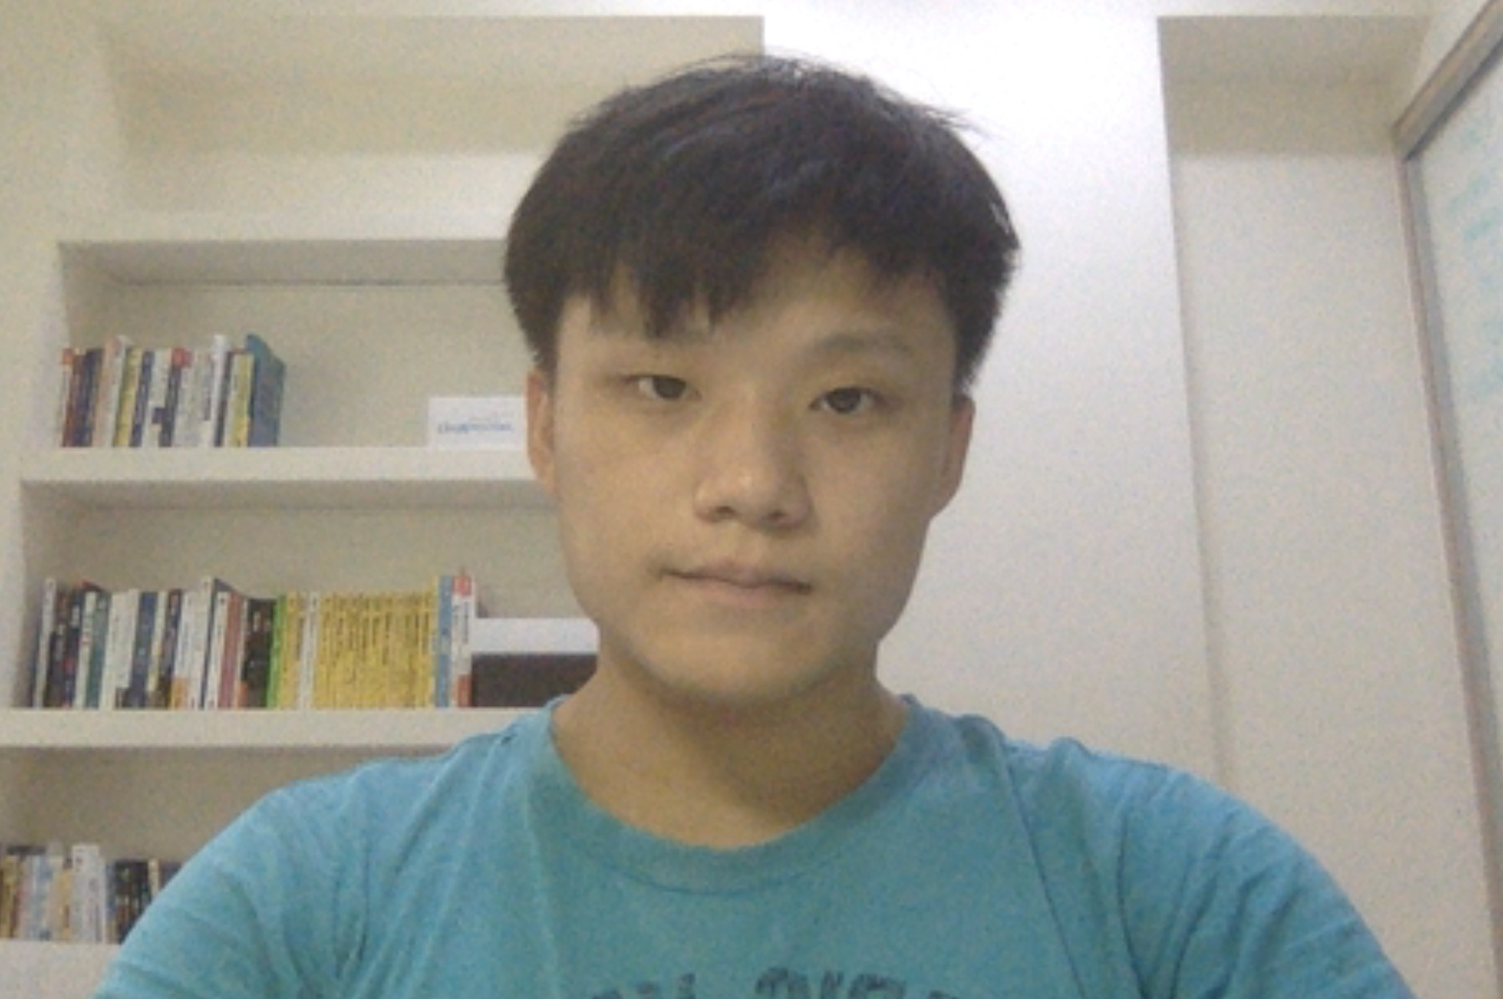
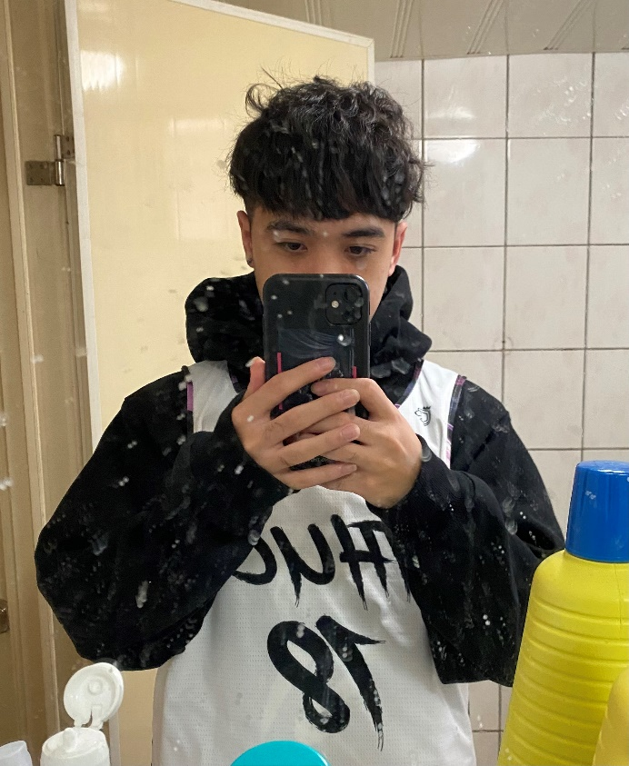
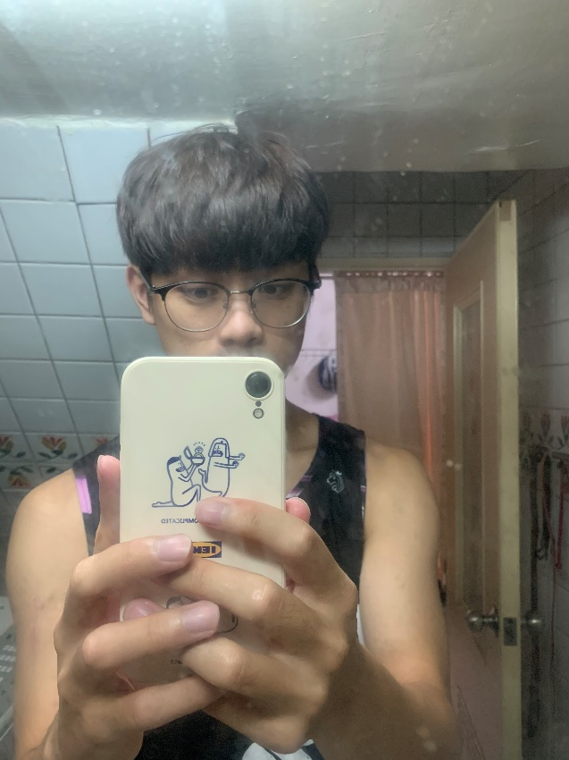
Team members
杜方辰
108062313
顏訓哲
108062122
鄭幃謙
108062119

Slide 3
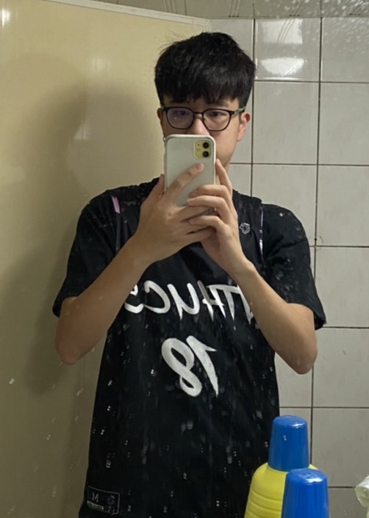
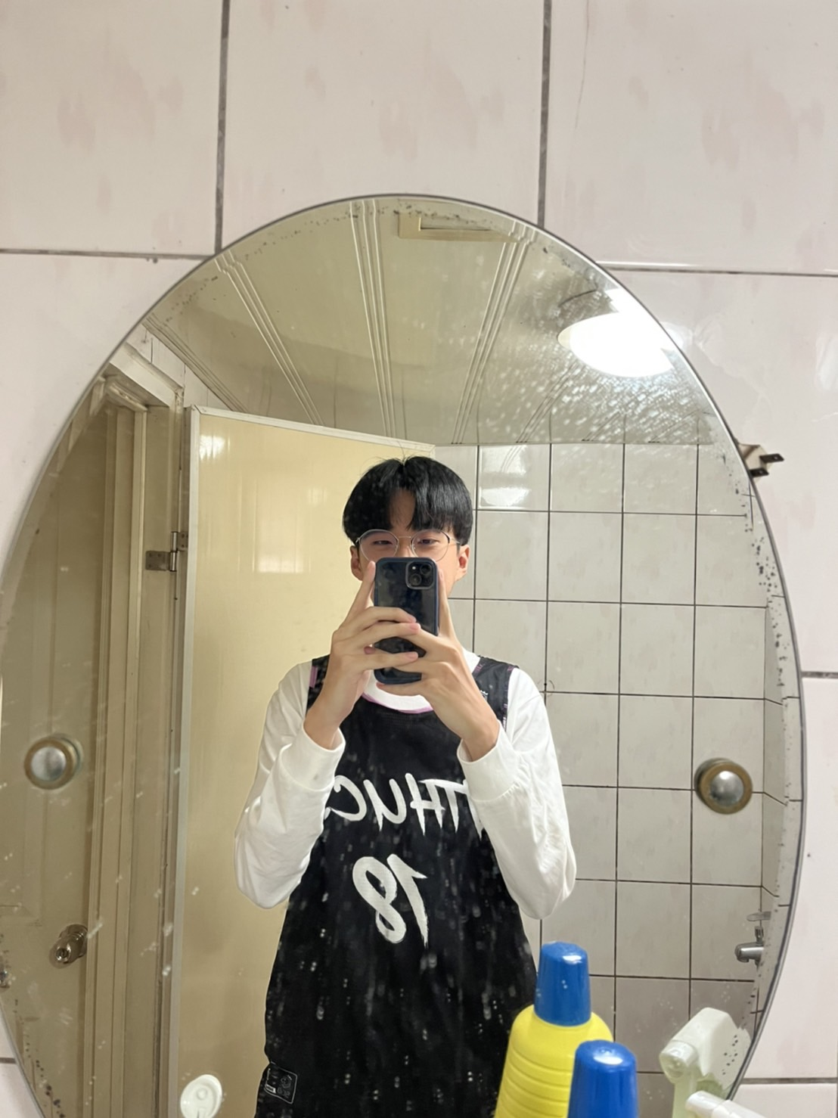
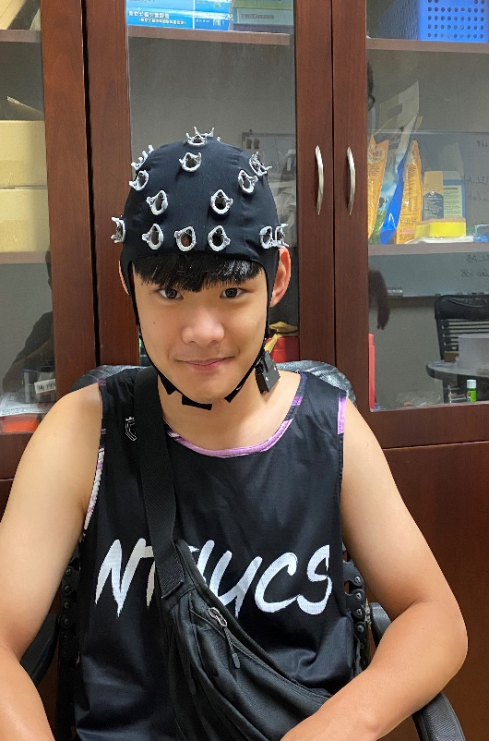
Team members
黃允暘
108062313
林湛悅
108062127
林晁璿
108062115

Slide 4
WHY?
Six basketball lovers
Six gambling lovers

Slide 5
GOAL
Predicting a game result
Winning money

Slide 6
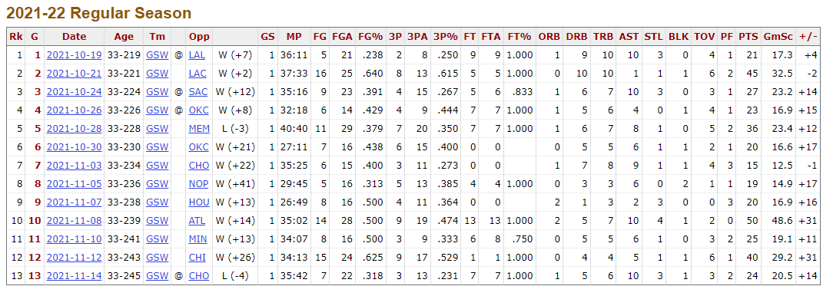
HOW
Get dataset:
Pick a appropriate model
Train model
Predict

Slide 7
SCHEDULE
~12/12 : preprocess the data
12/12~12/26 build model
12/26~1/3 adjust model
1/4 demo

